Slide 1




BMED 6963/4963-01
Lab 1: MatLab Intro
Ge Wang, PhD
Biomedical Imaging Center
CBIS/BME, RPI
wangg6@rpi.edu
January 20, 2017

Slide 2
BB Schedule for S18
Tue | Topic | Fri | Topic
1/16 | Introduction | 1/19 | MatLab I (Basics)
1/23 | System | 1/26 | Convolution
1/30 | Fourier Series | 2/02 | Fourier Transform
2/06 | Signal Processing | 2/09 | Discrete FT & FFT
2/13 | MatLab II (Homework) | 2/16 | Network
2/20 | No Class | 2/23 | Exam I
2/27 | Quality & Performance | 3/02 | X-ray & Radiography
3/06 | CT Reconstruction | 3/09 | CT Scanner
3/20 | MatLab III (CT) | 3/23 | Nuclear Physics
3/27 | PET & SPECT | 3/30 | MRI I
4/03 | Exam II | 4/06 | MRI II
4/10 | MRI III | 4/13 | Ultrasound I
4/17 | Ultrasound II | 4/20 | Optical Imaging
4/24 | Machine Learning | 4/27 | Exam III
Office Hour: Ge Tue & Fri 3-4 @ CBIS 3209 | wangg6@rpi.edu
Kathleen Mon 4-5 & Thurs 4-5 @ JEC 7045 | chens18@rpi.edu

Slide 3
RPI-Formula for Effective Learning
Preview
Old Videos/PPTs, Text Books
In-class
Classroom, Office Hours
Review
Read Book Chapters Thoroughly
Discuss with Fellow Students, TA, & Ge
Do Homework
Search on Google for More Info

Slide 4
Digital Properties from Spring’17
Class Videos
Professionally Recorded
PPTs
Available with Videos
Textbook
Available in PDF
Schedule
Same or Very similar

Slide 5
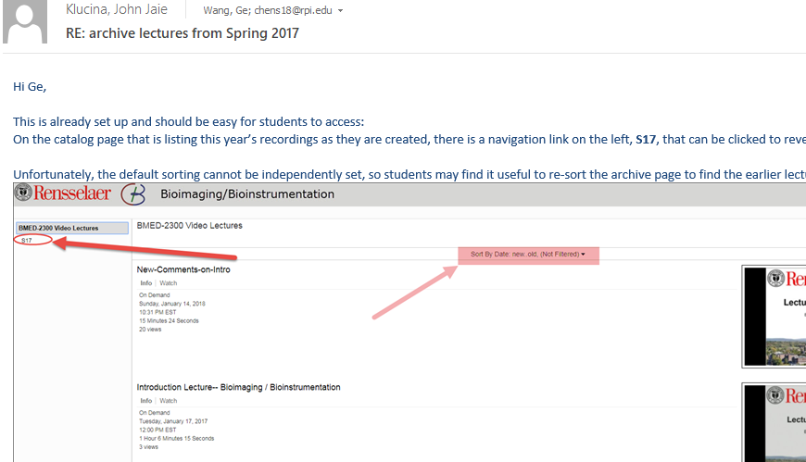
S17 Videos

Slide 6
MatLab Issue
Professor Wang,
Hello I am enrolled in your class. I am concerned about an issue pertaining to MatLab. For the past four days I have been unable to install MatLab because I cannot get through CAS. This problem is occurring with other RPI students as well. I will be going to the help center to get MatLab installed in my computer as soon as possible. If there is anything more I can do please let me know.
-XYZ

Slide 7
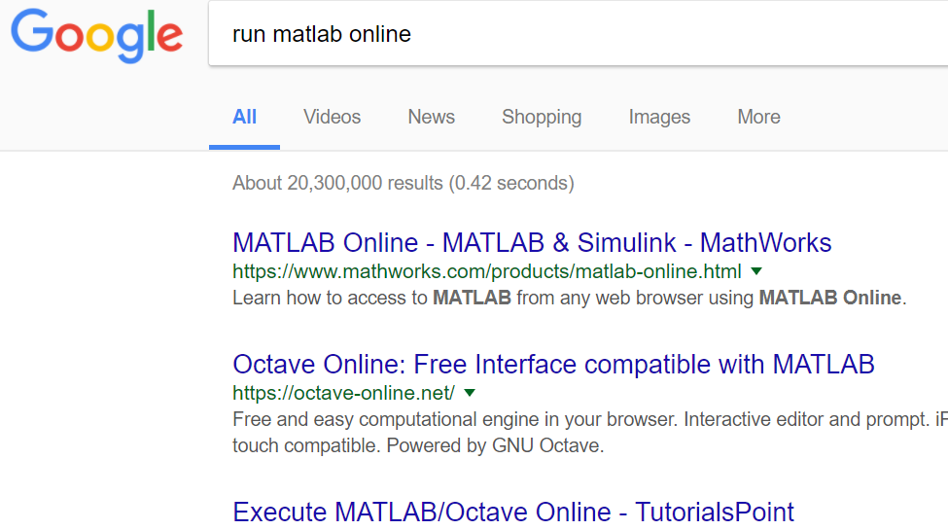
Where There's a Will…

Slide 8
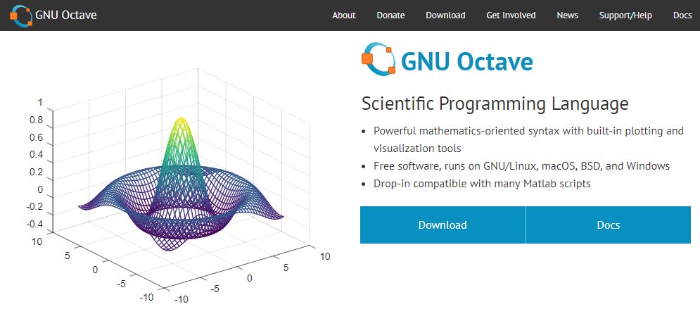
Octave: MatLab in Disguise

Slide 9
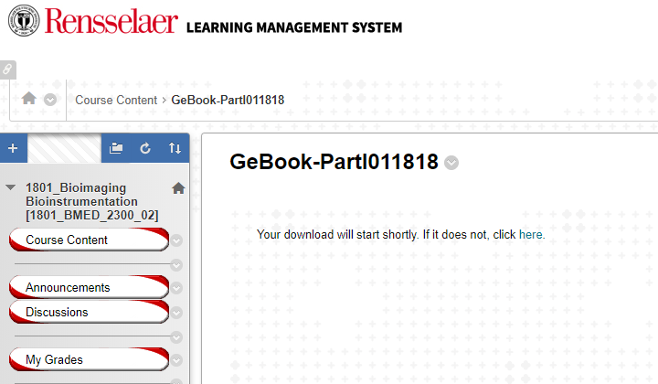
Ge’s Book Part I

Slide 10
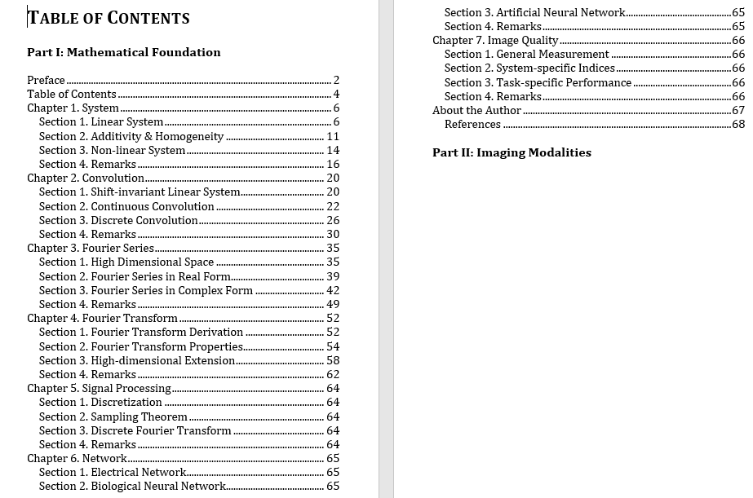

Slide 11
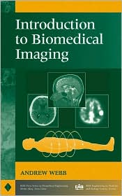

Slide 12
Outline
Download & Installation
OnRamp Review
Examples
Spectral Shifts of Stars
Plotting a 3D cone surface
Exploring MATLAB Packages
Image Processing
Instrument Control
Optimization
Stats & Machine Learning
Symbolic Math

Slide 13
Download & Installation
http://dotcio.rpi.edu/services/software-labs
Follow directions according to your OS
Activate using product key

Slide 14
Outline
Download & Installation
OnRamp Review (In MATLAB)
Examples
Spectral Shifts of Stars
Plotting a 3D cone surface
Exploring MATLAB Packages
Image Processing
Instrument Control
Optimization
Stats and Machine Learning
Symbolic Math

Slide 15
OnRamp Review and Demo
Desktop Layout
Creating Variables/Built-in Commands
Vectors & Matrices
Importing Data
Indexing & Modifying Arrays
Array Calculations
Calling Functions
Obtaining Help
Plotting
Scripts
Logical Arrays

Slide 16
Outline
Download & Installation
OnRamp Review (In MATLAB)
Examples
Spectral Shifts of Stars
Plotting a 3D cone surface
Exploring MATLAB Packages
Image Processing
Instrument Control
Optimization
Stats and Machine Learning
Symbolic Math

Slide 17
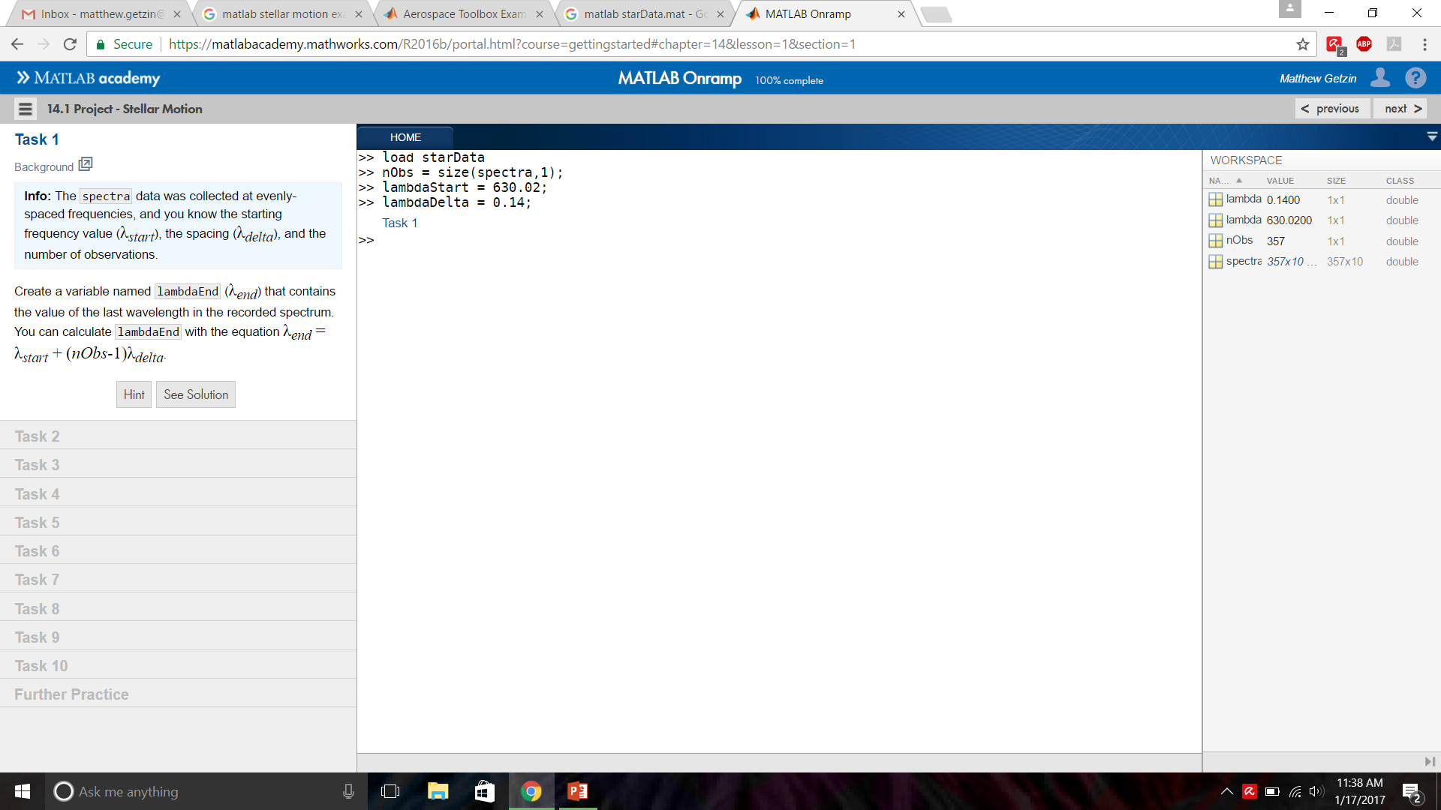
Example: Stellar Motion

Slide 18
Answer: Stellar Motion
lambdaEnd=lambdaStart+(nObs-1)*lambdaDelta;
lambda=[lambdaStart:lambdaDelta:lambdaEnd]';
s=spectra(:,6);
loglog(lambda,s,'.-');
hold on
[sHa,idx]=min(s);
lambdaHa=lambda(idx);
loglog(lambdaHa,sHa,'rs','MarkerSize',8);
z=(lambdaHa./656.28)-1;
speed=3e5.*z;

Slide 19
Outline
Download & Installation
OnRamp Review (In MATLAB)
Examples
Spectral Shifts of Stars
Plotting a 3D cone surface
Exploring MATLAB Packages
Image Processing
Instrument Control
Optimization
Stats and Machine Learning
Symbolic Math

Slide 20
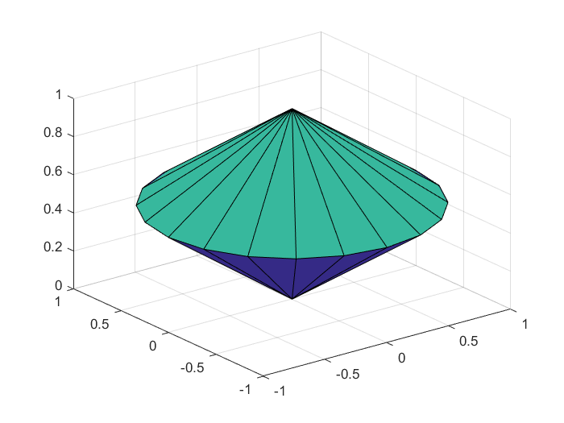
Example: Plotting a 3D cone

Slide 21
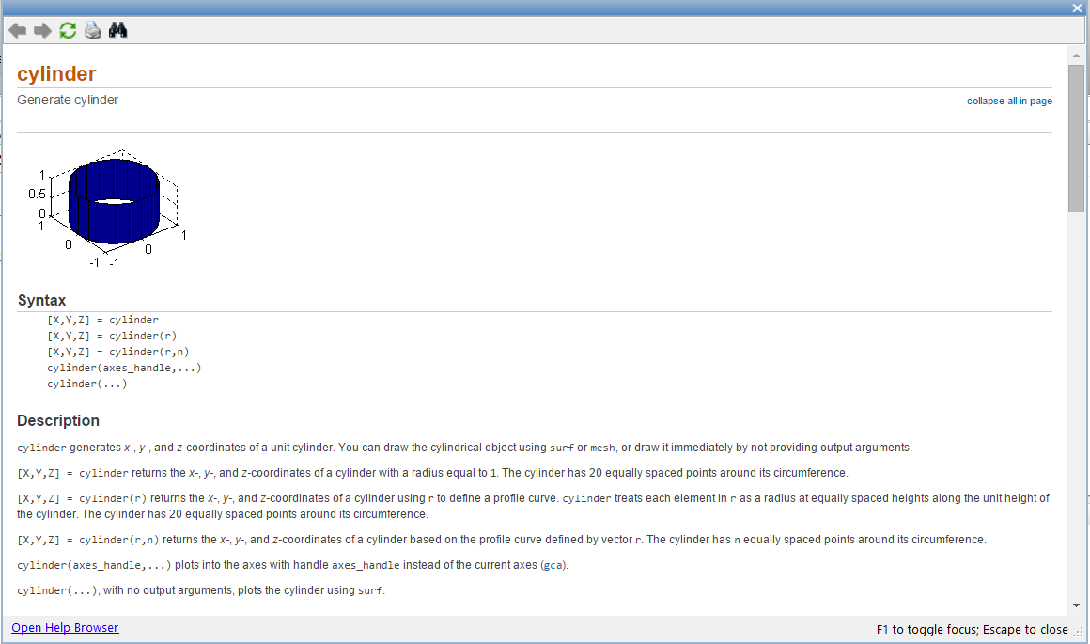
Answer: Plot a 3D Cone
t = [0 1 0];
[X,Y,Z] = cylinder(t);
surf(X,Y,Z);

Slide 22
Outline
Download & Installation
OnRamp Review (In MATLAB)
Examples
Spectral Shifts of Stars
Plotting a 3D cone surface
Exploring MATLAB Packages
Image Processing
Instrument Control
Optimization
Stats and Machine Learning
Symbolic Math

Slide 23
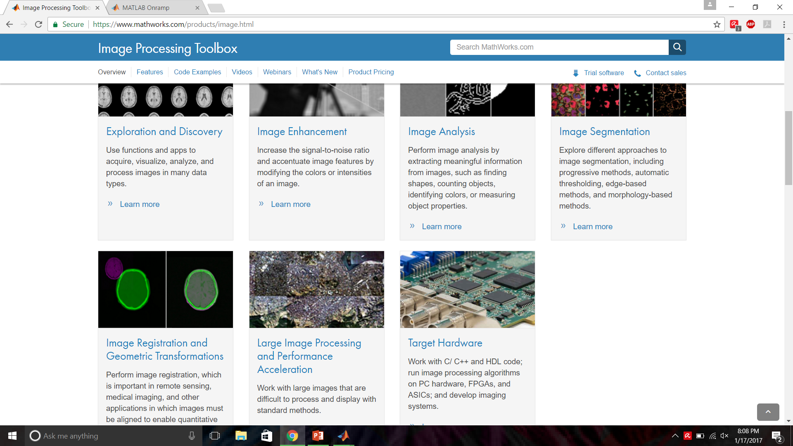
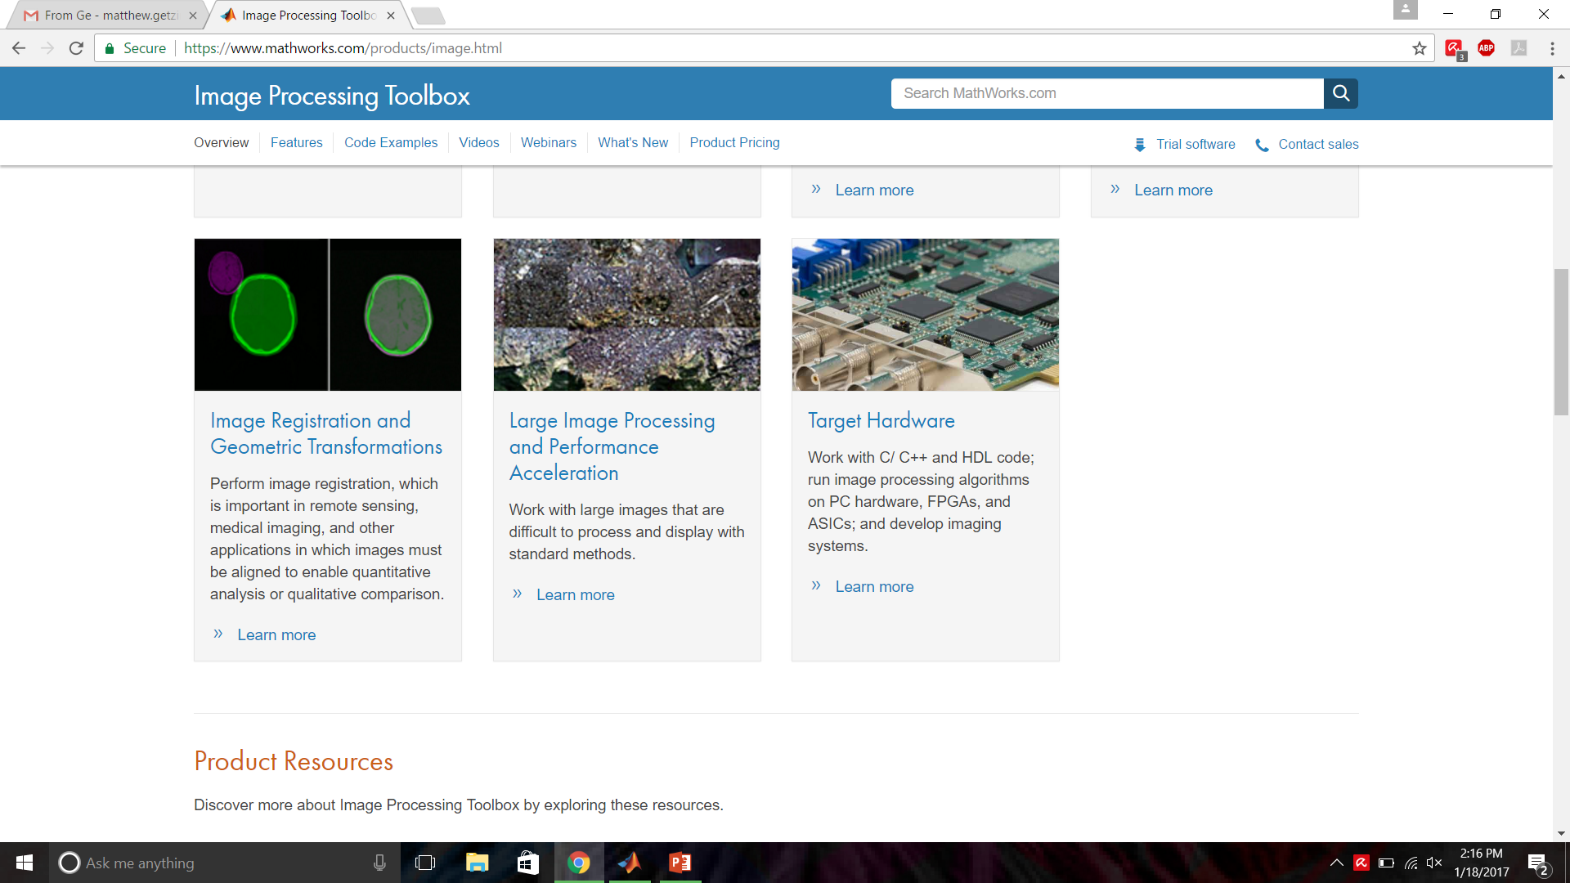
Image Processing Toolbox

Slide 24
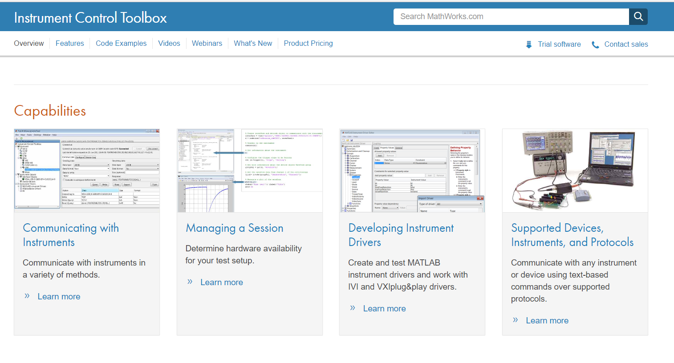
Instrument Control Toolbox

Slide 25
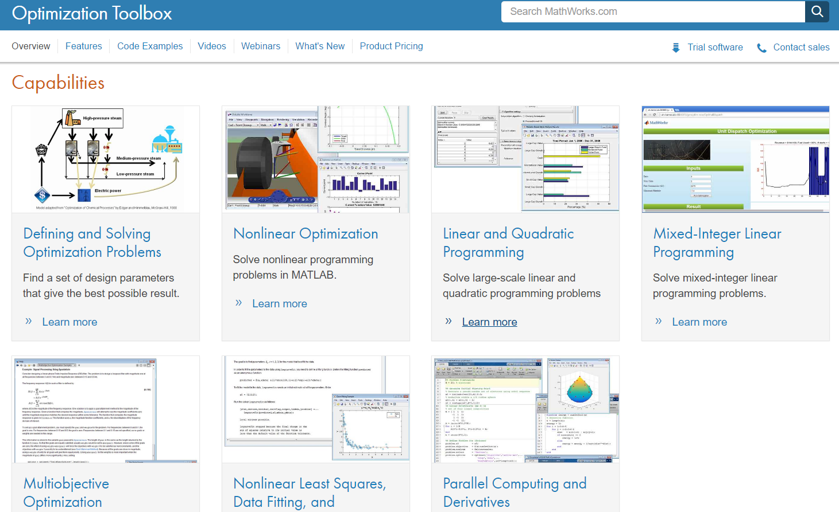
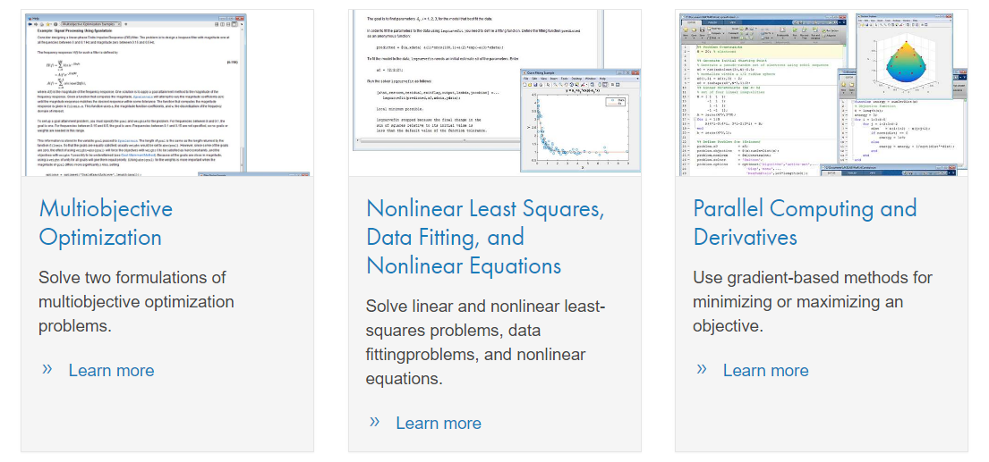
Optimization Toolbox

Slide 26
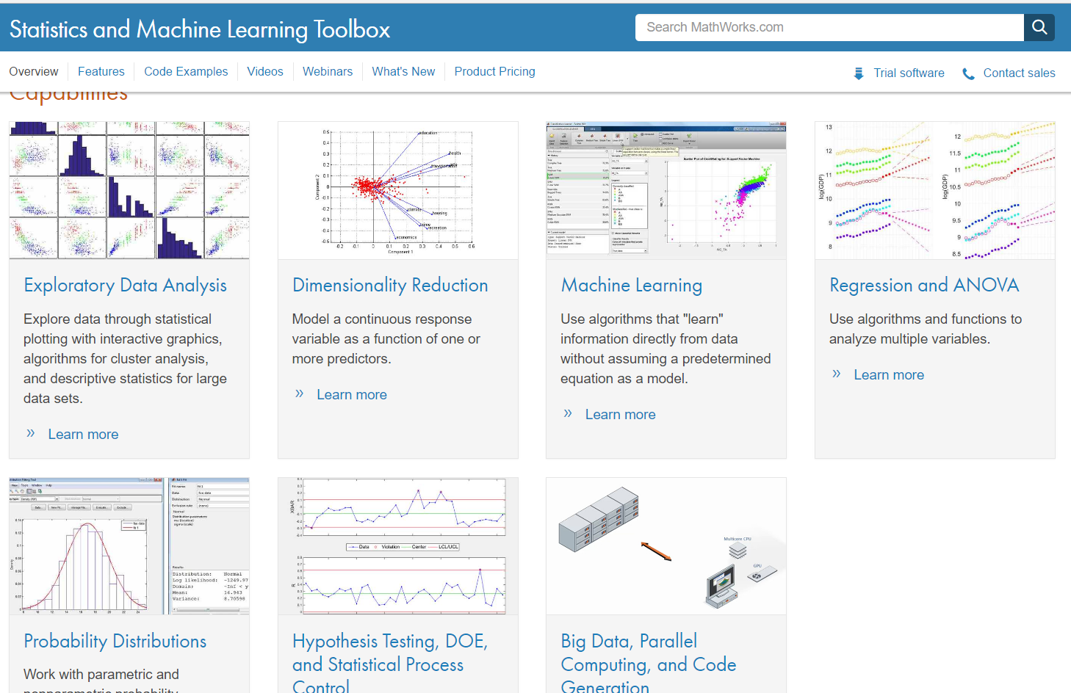
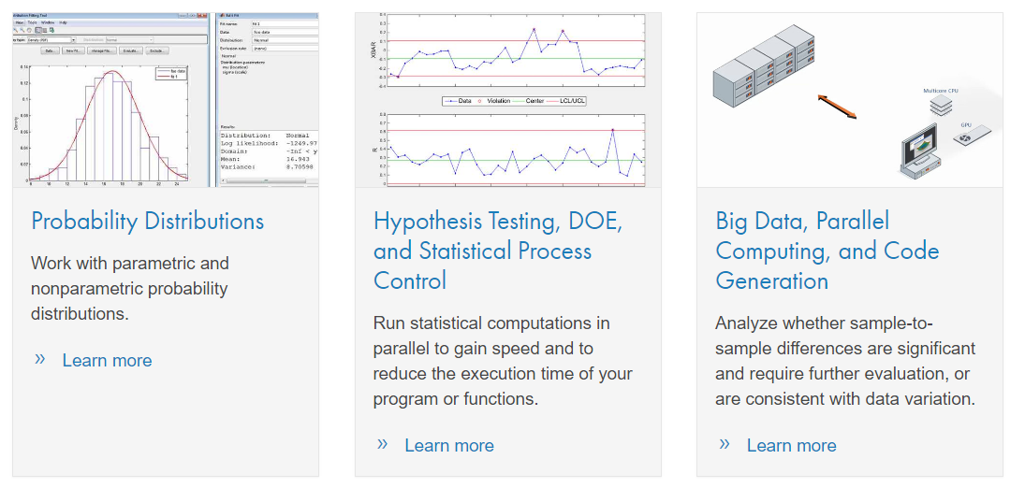
Statistics and Machine Learning Toolbox

Slide 27
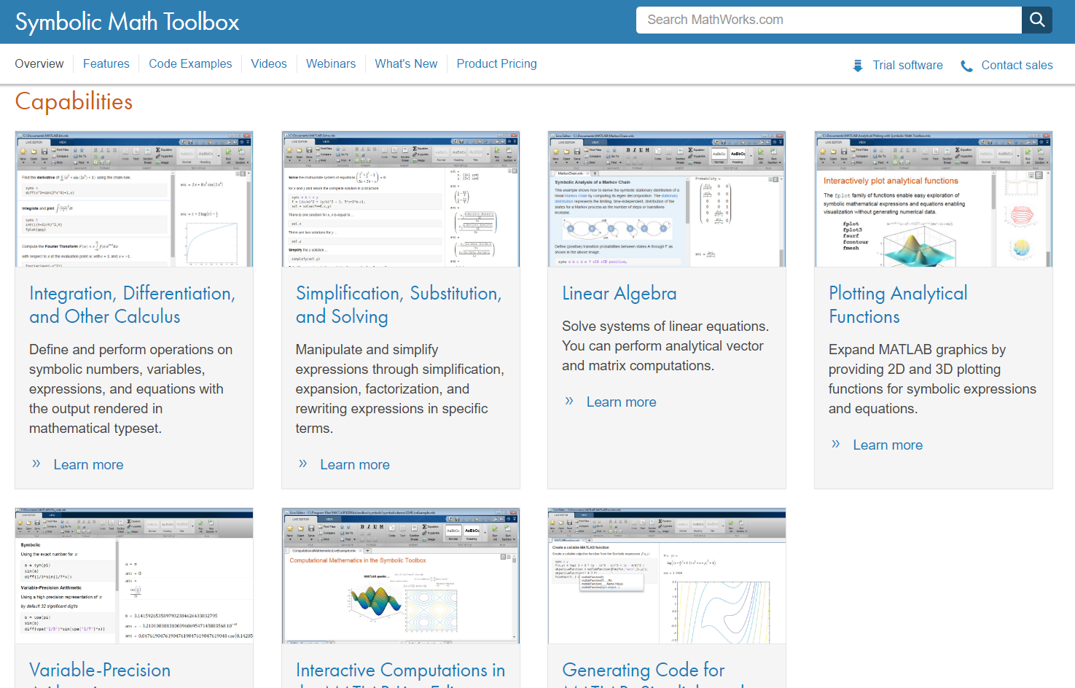
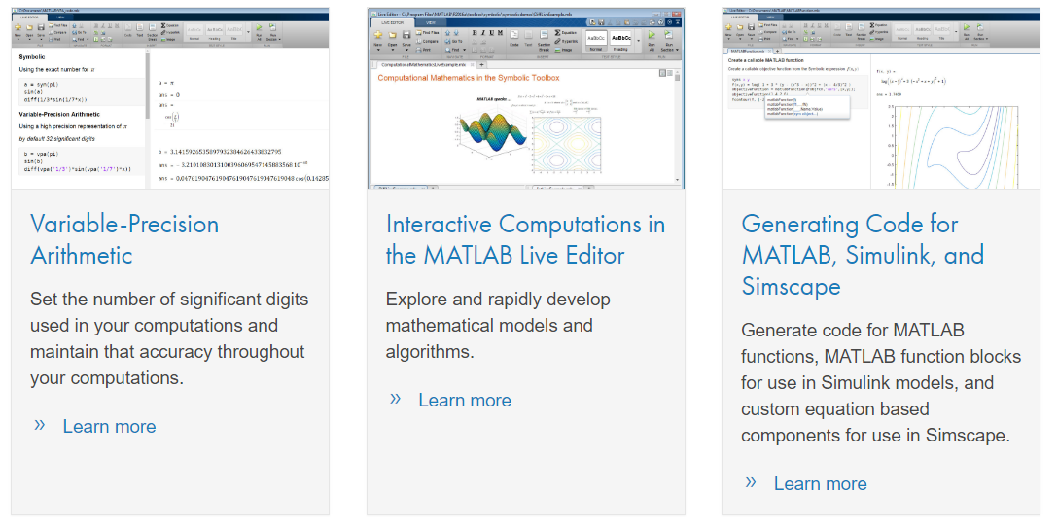
Symbolic Math Toolbox

Slide 28
Help & Documentation
F1 – while cursor in or after a built-in command
Command >> help topic
https://www.mathworks.com/support/?s_tid=gn_supp
https://www.google.com
http://stackoverflow.com/questions/tagged/matlab
http://www.mathworks.com/matlabcentral/fileexchange/?s_tid=gn_mlc_fx

